Slide 1

Eclipse EMF
Trainer name
City and date

Slide 2
About me: Ralf Ebert
Professional Java developer for 5 years
Primarily specializing in client-side development
    Web Applications
    Rich client applications
    Human-Computer Interaction and UI design
Consulting for a large German trading group:
Swing to Eclipse RCP migration project
User of Eclipse IDE for 4 years
ebert@weiglewilczek.com

Slide 3
About me: Ilya Shinkarenko
Software engineer / Consultant at Weigle Wilczek GmbH
      Java EE, Eclipse
      HCI, Usability
10 years of professional development
      Sun Certified Java Programmer
      Certified JBoss Developer
3+ years of Eclipse development
      >10 Eclipse-based projects
      Workshops, Seminars, Consulting
      Eclipse RCP Training concept
shinkarenko@weiglewilczek.com

Slide 4
About me: Alexander Thurow
Training / Coaching
Software engineer at Weigle Wilczek GmbH
6 years of Java development
    JEE on JBoss AS
4 years of Eclipse IDE
2 years of Eclipse RCP development
    Involved in 3 ongoing RCP projects
thurow@weiglewilczek.com

Slide 5
About me: Aleksey Aristov
Senior Software Architect at Weigle Wilczek GmbH
    Java EE, Eclipse
    C++
10+ years of professional development
    Certified Java Programmer for the Java 2 Platform
    Certified JBoss Consultant
    Certified Scrum Master
5+ years of professional Eclipse development
    >15 Eclipse-based projects
    Workshops, Seminars, Consulting
aristov@weiglewilczek.com

Slide 6
About me: Patrick Menard
Professional Java developer for 4 years
Focused on human interface design
Primarily specialized on
    Web Applications
    Rich client applications
User of Eclipse IDE for 1 year
menard@weiglewilczek.com

Slide 7
The Eclipse Training Alliance
» Founded December 2005 by WeigleWilczek and Innoopract
» WeigleWilczek now drives the initiative
with Innoopract as premium partner.
» Goals:
» International one-stop offer of high quality Eclipse training classes
» Certificates
» Coaching and consulting
» Focus instructor-led classroom instruction
and in-depth hands-on labs and tutorials
» We share expertise.

Slide 8







Partners of the Eclipse Training Alliance
Founder of the Eclipse Training Alliance (worldwide)
Maker of Eclipse distribution Yoxoy (Germany; USA)
France, Spain
Benelux
Switzerland
Scandinavia
China

Slide 9
Training classes of the Eclipse Training Alliance
Eclipse RCP
Enterprise Applications with Eclipse RCP
Effective Usage of the Eclipse IDE
Eclipse EMF, GEF and GMF
Professional web Development with RAP
Lotus Notes 8 and Eclipse RCP
Legal Introduction to Open Sourse Licensing
Upcomming Training classes:
  Agility with Eclipse and Mylin (already available in NL)
  BIRT (already available in CH and USA

Slide 10
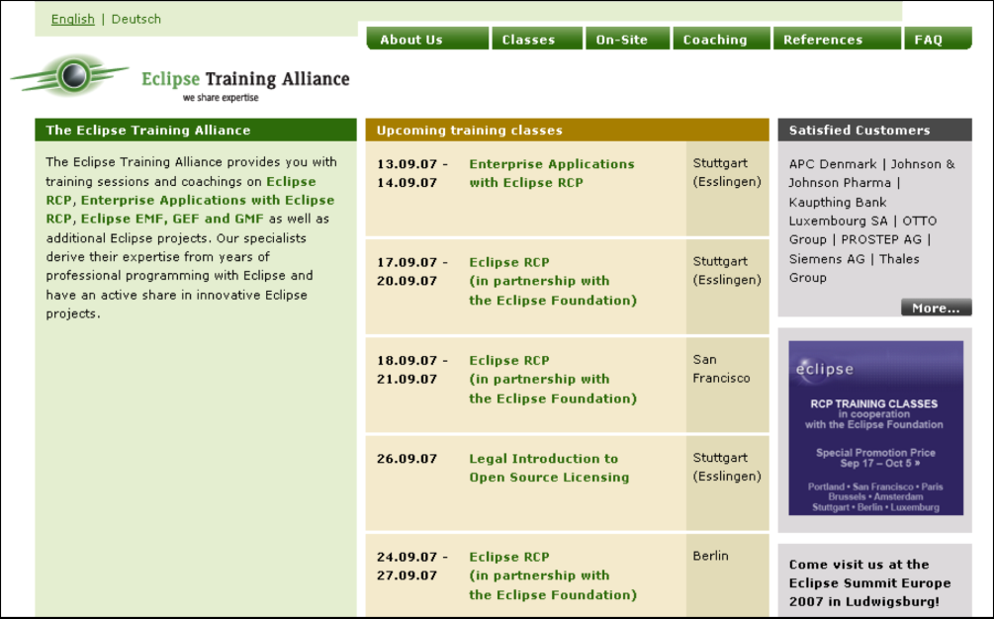
Eclipse Training Alliance: contact Europe
Please contact us for details:
Eclipse Training Alliance
c/o Weigle Wilczek GmbH
Dr. Jörn Weigle
Martinstraße 42-44
D-73728 Esslingen
Phone (+49) 711 45 99 98 0
Fax (+49) 711 45 99 98 29
www.eclipse-training.net

Slide 11

Eclipse Training Alliance: contact USA
Please contact us for details:
Eclipse Training Alliance
c/o Innoopract Inc.
Sanna Kaldner
351 NW 12th Avenue
Portland, OR 97 209
Phone (+1) 888 679 8753
e-mail skaldner@innoopract.com
www.eclipse-training.net

Slide 12
Training philosophy
We teach the basic concepts and patterns
» Almost everything is learned by practice: "learning by doing"
» Approximately 40% theory, 60% practice
» Use Eclipse sources as an example
» Learn to work effectively in Eclipse IDE (shortcuts, tips & tricks)
» There are no stupid questions!

Slide 13
Who is everybody?
Java experience?
GUI programming with Swing/ AWT?
Experience with Eclipse as IDE?
Experience with Eclipse as a platform for riche client applications?
Other technical background?

Slide 14
Agenda
Showcase
Eclipse Platform
Eclipse Plug-in Development – recap
Model-Driven Software Development
Draw2D and Graphical Editing Framework
Eclipse Modeling Project
EMF – Eclipse Modeling Framework
Graphical Modeling Framework

Slide 15
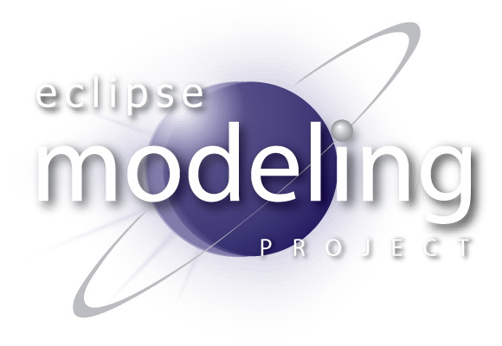
Demo
Vocabulary
  Framework
  Toolsmith
  Practitioner
  Model and meta-model
  Semantic and Notation model

Slide 16
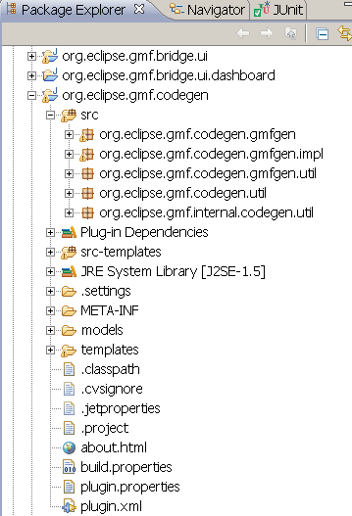
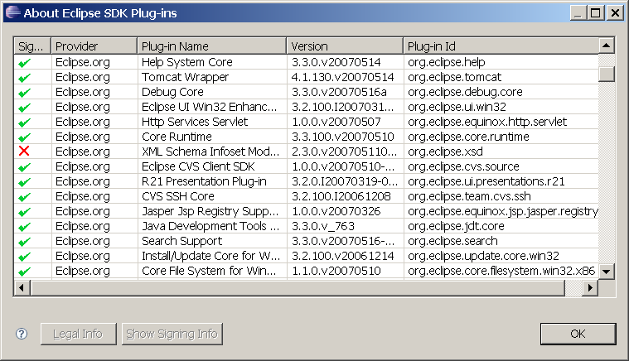
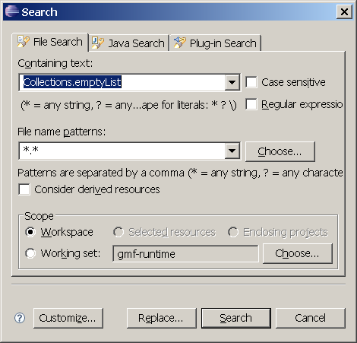
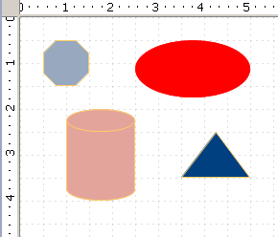
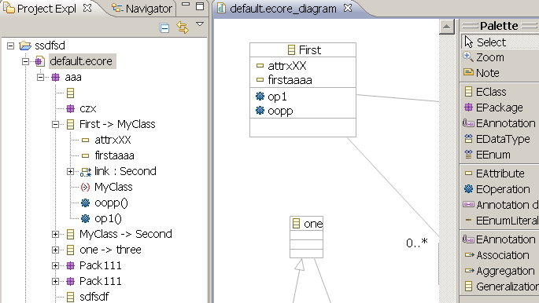
Supportive Eclipse Subsystems
Platform
  OSGi
  SWT and JFace
  Resources
Tools
  Draw2D and GEF
Modeling
  Eclipse Modeling Framework
  Graphical Modeling Framework

Slide 17
Eclipse Platform
Runtime based on OSGi™ standard
  A dynamic module system for Java™ (‘bundles’)
  Service-oriented, component-based, lifecycle management
Plug-in architecture
  Manifest: plug-in identification, dependencies, etc.
  Extension-point: published declaration for extensibility (interface)
  Extension: a contribution to an extension-point (implementation)
Eclipse is a small runtime kernel and a collection of plug-ins
  All functionality is provided by plug-ins
  Plug-ins are activated only as needed
  Many provided “building bocks” for application development
Notes:
http://www.osgi.org

Slide 18
Why is Eclipse interesting?
Extensible
Platform independence
Native look and feel
GUI frameworks
Rich ecosystem of offerings
  Eclipse, other open source communities and products

Slide 19
What gives Eclipse its power?
Equinox – the Eclipse runtime
Modular
  Building platforms requires componentization
  Function is captured in self-describing bundles
Dynamic
  Bundles can be installed, started, stopped, uninstalled at any time
Standard
  Based on the Service Platform Specification R4 from the OSGi Alliance

Slide 20
OSGi, Eclipse and Equinox
OSGi Alliance
  Produces open specifications for runtime environments
  Traditional focus on embedded (home gateway, telematics, …)
  Broadening scope – desktops, enterprise and servers
  Several open source implementations including Equinox
Eclipse
  Eclipse 3.0 saw the rise of Eclipse the Rich Client Platform (RCP)
  Needed a standard, open, flexible, dynamic, modular runtime to replace the proprietary Eclipse runtime
  Eclipse has been OSGi-based since 3.0 (3 years, 3 releases)
Equinox
  Eclipse OSGi implementation
  OSGi R4 and R4.1 reference implementation
  Consistent component story across computing environment and domains

Slide 21
OSGi: Dynamic Modules for Java
bundle
Modularity system for Java
Bundle is the unit of modularization
  Plug-in == Bundle
  Roughly equivalent to a JAR
  Self-described using MANIFEST.MF metadata
The Framework manages dependencies and lifecycle of bundles
  Explicitly supports dynamic scenarios
Bundles interact through
  Java package sharing
  OSGi Service registry
  Eclipse Extension Registry
bundle
bundle
bundle
Equinox OSGi
JavaTM Runtime

Slide 22
Eclipse Modeling Project and MDSD
Modern trend – DSLs, Software Factories
Eclipse Modeling Project
  EMF – Eclipse Modeling Framework
  GMF – Graphical Modeling Framework
  M2M – Model-To-Model Transformations
  M2T – Model-To-Text
  MDT – Model Development Tools
  EMFT – Technology and Research
Other MDSD Tools

Slide 23
Domain-Specific Languages/Modeling
Definitions (from Wikipedia):
  DS(P)L = “A domain-specific programming language (domain-specific language, DSL) is a programming language designed to be useful for a specific set of tasks.”
  DSM = “Domain-specific modelling (DSM) is the systematic use of Domain Specific Languages (DSLs) to express the various facets of information systems.”
DSLs can be defined in many ways
  Traditional grammar definition languages, XSD, MOF, ECore, etc.
  ECore is a DSL for defining modeling languages
Tooling can be generated, represented in models, queried, transformed to other models, used to drive code generators, etc.
Focus is on the problem domain, not the implementation technologies
  Sounds very familiar to object modelers

Slide 24
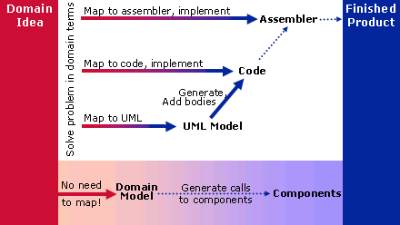
Domain-Specific Languages/Modeling
From DSM Forum’s “Why DSM?” page:
OK, so what about the UML? …

Slide 25
The UML vs. DSL/DSM
The UML is a general purpose modeling language
  Similar to general purpose programming languages (e.g. Java)
  Can be seen as a collection of DSLs
  Can be used to define a DSL (i.e. profiles) and therefore DSM tools
OMG has trademark on MDA
  A collection of standards
  Models defined in MOF/UML, refined/constrained/queried (OCL), transformed (QVT), and used to generate text (MOF2Text),…
  MDA is often synonymous with Model-Driven Development (MDD)
    And, Model-Driven Engineering (MDE), and…
The UML metamodel can be the starting point of your DSM tool
  How importants are standards to you?

Slide 26
An Analogy (from Wikipedia)
A Very Little Language is like a knife, which can be used in thousands of different ways, from cutting food to cutting down trees.
A DSL is like an electric drill: it is a powerful tool with a wide variety of uses, but a specific context, namely, putting holes in things (although it might also be used to mix paint or remove screws).
A General Purpose Language is a complete workbench, with a variety of tools intended for performing a variety of tasks.
DSLs should be used by programmers who, looking at their current workbench, realize they need a better drill, and find that a specific DSL provides exactly that.
Notes:
http://en.wikipedia.org/wiki/General-purpose_programming_languages

Slide 27
Advantages and Disadvantages (also from Wikipedia)
Advantages
DSLs allow solutions to be expressed in the idiom and at the level of abstraction of the problem domain. Consequently, domain experts themselves can understand, validate, modify, and often even develop DSL programs.
Self-documenting code.
DSLs enhance quality, productivity, reliability, maintainability, portability and reusability.
DSLs allow validation at the domain level. As long as the language constructs are safe any sentence written with them can be considered safe.
Disadvantages
Cost of designing, implementing, and maintaining a DSL
Finding a proper scope
The difficulty of balancing between domain-specificity and general-purpose programming language constructs.
The potential loss of processor-efficiency when compared with hand-coded software.
Notes:
http://en.wikipedia.org/wiki/General-purpose_programming_languages

Slide 28

Domain-Specific Languages/Modeling
DSLs and DSM are popular topics lately…
  DSM Forum
    http://www.dsmforum.org/
  Language Workbenches
    http://www.martinfowler.com/articles/languageWorkbench.html
  Microsoft’s DSL Toolkit
    http://msdn.microsoft.com/vstudio/dsltools/
  Eclipse Modeling Project
    http://www.eclipse.org/modeling/
    Specifically, see Graphical Modeling Framework (GMF) project…
Notes:
http://en.wikipedia.org/wiki/Domain-specific_programming_language
http://www.martinfowler.com/bliki/DomainSpecificLanguage.html

Slide 29
EMF – Eclipse Modeling Framework
Abstract Syntax
A modeling & data integration framework
  Specification of your application’s data
    Object attributes
    Relationships (associations) between objects
    Operations available on each object
    Simple constraints (eg. cardinality) on objects and relationships
Technologies
  Validation – a flexible framework for contributing 3rd-party constraints to model validation
  Query – an SQL-like Java API for querying EMF resources
  Transaction – a transaction protocol for concurrent access to EMF resources

Slide 30
GMF – Graphical Modeling Framework
Concrete Syntax development
Generative component and runtime infrastructure for developing graphical editors based on EMF and GEF
Significantly reduces cost of DSL tooling

Slide 31
M2M – Model To Model Transformations
Deliver a framework for model-to-model transformation languages
ATL (formely from GMT) – a hybrid language (a mix of declarative and imperative constructions) designed to express model transformations. ATL is described by an abstract syntax (a MOF meta-model), and a textual concrete syntax. A transformation model in ATL is expressed as a set of transformation rules
QVT - standardizing the way transformations are achieved between models whose languages are defined using MOF. In addition, QVT offers a standard way of querying MOF models, and creating views onto these models
  Relations: A user-friendly Relations meta model and language which supports complex object pattern matching and object template creation. Traces between model elements involved in a transformation are created implicitly.
  Core: A Core meta model and language defined using minimal extensions to EMOF and OCL. All trace classes are explicitly defined as MOF models, and trace instance creation and deletion is defined in the same way as the creation and deletion of any other object.
  Operational: an imperative language.
Notes:
Operational QVT is not part of project plan

Slide 32
M2T – Model To Text
Generation of textual artefacts from models
JET and JET2 – code generation framework & facilities that are used by EMF. JSP-like template files.
xPand
  Essentially, a collection of languages from oAW
  model-aware, breakdown, polymorphic
MTL – an implementation of the Object Management Group (OMG) MOF Model to Text Language (MTL) standard
Editor support
Compile/build/analyze/report errors support
Notes:
XXX might want to add snippets to show differences bw xpand/jet

Slide 33
MDT – Model Development Tools
UML2 - an EMF-based implementation of the UMLTM 2.x metamodel for the Eclipse platform
OCL – an implementation of the Object Constraint Language for Ecore and UML meta-models
EODM – an implementation of the Ontology Definition Metamodel for ECore
UM2 Tools – a set of GMF-based editors for viewing and editing UML models
XSD – a library that provides an API for manipulating the components of an XML Schema as described by the W3C XML Schema specifications, as well as an API for manipulating the DOM-accessible representation of XML
JET Editor – rich text editor component for editing JET templates within Eclipse. The editor features syntax coloring, error highlighting and code completion

Slide 34
EMFT – Technology and Research
A collection of components that “add on” to EMF to provide value-added capabilities for rich applications
Persistence:
  CDO – object-relational mappings for persistence of EMF resources in RDBMSes
  Teneo – support for Hibernate and JPOX/JDO
Net4j – extensible client-server system based on the Eclipse Runtime and the Spring Framework.
Search and Compare
JET Editor – a rich editor for JET templates
GMT

Slide 35
Meta-modeling
Standards. OMG
  MOF, UML, XMI, DI
  MDA
Abstract and Concrete Syntax
  AST, UML, HUTN
  Textual Notation
    HUTN
    SAFARI
    xText
    TMF/TNT Proposal

